Slide 1
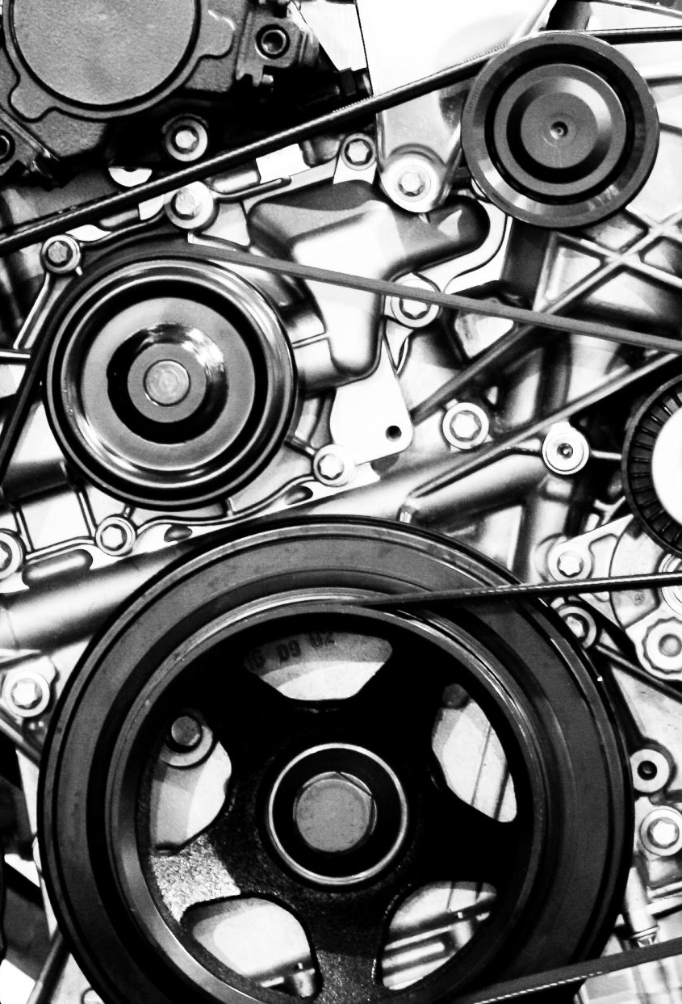
Compute Engine

Slide 2
Compute Engine
Google Cloud service for creating and managing virtual machines
Offers wide variety of VM-related services
IaaS

Slide 3
Virtual machines
A virtual (=not real) server running on a physical (=real) server
Allows creating new servers extremely quick
Based on existing resources of the physical server
From the user’s point of view – a regular server, nothing new
SLA of a single machine: 99.5%

Slide 4
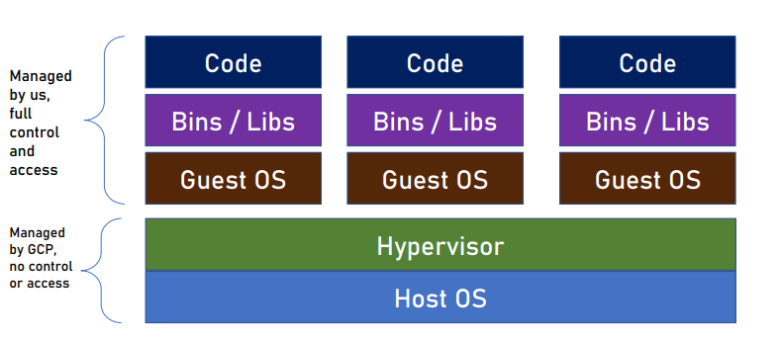
Virtual Machines Architecture

Slide 5
Advantages Of Compute Engine
Storage Efficiency: The persistent disks support up to 257 TB of storage. Organizations that require more scalable storage options can go for Compute Engine
Cost: Within the GCP ecosystem, users pay only for the computing time that they have consumed. The per-second billing plan is used by the Google compute engine.
Stability: It offers more stable services because of its ability to provide live migration of VMs between the hosts.
Backups: Google Cloud Platform has a robust, inbuilt, and redundant backup system. The Compute Engine uses this system for flagship products like Search Engine and Gmail.
Scalability: It makes reservations to help ensure that applications have the capacity they need as they scale.
Security: Google Compute Engine is a more secure and safe place for cloud applications.

Slide 6
VM Families
VMs in GCP are divided to families
Each family targets specific type of workload
Families are further classified by series and generation (usually
newer hardware)
Always make sure you select the appropriate VM family for your
needs
Documentation link :-
https://cloud.google.com/compute/docs/machine-resource

Slide 7
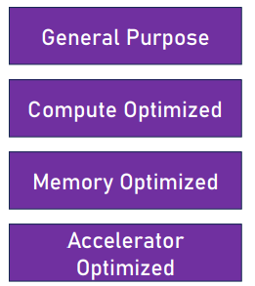
Workload Types
Web servers, microservices, virtual desktops, databases, etc
High-performance computing (HPC), game servers, media transcoding, etc.
SAP HANA databases, in-memory data stores (Redis), etc.
ML training, massively parallelized computation, deep learning etc

Slide 8
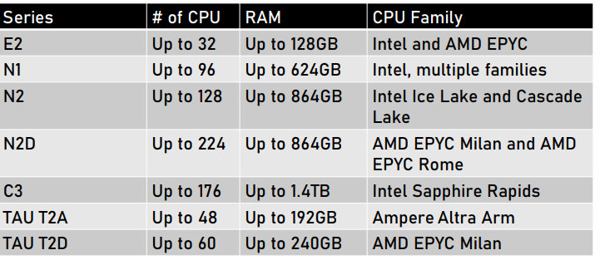
General Purpose
E2 :- Low traffic web server, back office apps, virtual desktops
N2, N2D, N1 :- Medium traffic web servers, microservices, BI
C3 :- High traffic web servers, databases, in-memory cache
TAU T2D, T2A :- ARM architecture, Cost effective, scale out workloads

Slide 9
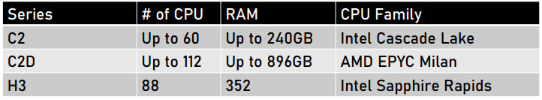
Compute Optimized
H3 :- HPC workload, scientific and engineering computing
C2, C2D :- Gaming, ad serving, media serving, AI/ML

Slide 10
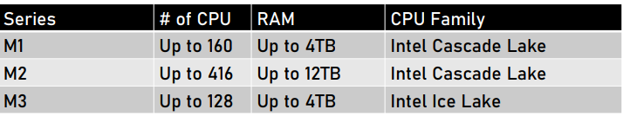
Memory Optimized
M1, M2, M3 :- SAP HANA, MS SQL, memory intensive apps

Slide 11
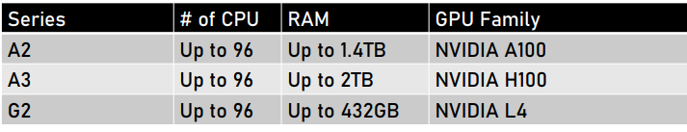
Accelerator Optimized
A2, A3 :- HPC, ML Training
G2 :- Video transcoding, Remote visualization

Slide 12
Additional GPU
Some VM series can use GPU in addition to CPU
The A2 and G2 series have built in support for GPU and no need to add it later
GPU can also be added to N1 machines
All GPUs are NVIDIA base

Slide 13
Custom Machines
If none of the predefined machine types fit your need you can create your own custom machine
Custom machines can be created in the E2, N2, N2D and N1 series
You define the number of CPU and the size of RAM
For example: 32CPU, 16GB RAM
Not all combinations are valid

Slide 14
Lab 1
Create and Connect to VM Instance

Slide 15

Cost Saving for Compute Engine

Slide 16
Spot Instances
Great way to save costs
Up to 91% discount
Instances that can be stopped and removed by Google at any time to use their resources
Use for batch processing, data analytics etc.
Don’t use for web apps and systems that need to be accessible
Same process as creating normal VM only select “Spot” under Advanced>provisioning model tab

Slide 17

Committed Use Discounts
Get deep discount for committing to use resources
Up to 70% discount
You pay the committed price regardless of the actual use
Commitment is for 1 or 3 years
Can commit to specific hardware or license
Can Avail this discount from “committed use discounts” tab under Compute Engine at GCP

Slide 18

Scheduled Shutdown
• VM operations can be scheduled
• Useful for VMs that are not needed 24X7
• Test / Dev
• Batch processing
• Instances can be shutdown when not in use, saving costs
• Done using Instance Schedules

Slide 19
Lab 2
Schedule to start-stop VM

Slide 20
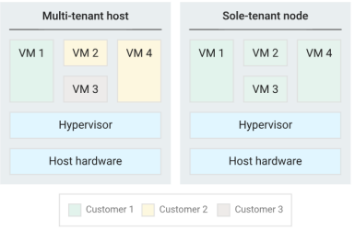
Sole Tenancy
By default, VM instances are placed on physical servers that host VM instances of other GCP customers
You can have a dedicated physical server for your VMs
This is called “Sole Tenant Nodes”
Quite expensive

Slide 21

Data Disks
When creating VM instance it’s important to select the best disk type for it
Disk type affect the reliability, speed and cost
Works as extra storage for vm
Can be read/write or read only
https://cloud.google.com/compute/docs/disks

Slide 22
Disk Type Families
Two types of disks, local and persistence
Local Disks
Attached to the physical host of the VM
Provides the best performance
Ephemeral – when the VM shuts down data is lost
Best for temporary data
Size is always 375GB
Can attach multiple disks per VM
Price depends on region, usually 0.08$ / GB
30$ / month
Persistence Disks
Durable network storage
Zonal or Regional
Can be detached and moved from a VM
Auto scale

Slide 23
Types of Persistent Disk
Balanced
SSD
Balances performance and cost
Best for general purpose systems
Performance
SSD
For high-performance databases
Designed for single-digit millisecond latencies
Standard
HDD
Large data processing
Extreme
SSD
Consistent high performance
Provision your target IOPS

Slide 24
Lab 3
Create and Attach disk to VM

Slide 25

VM Metadata
Every VM stores metadata in a special metadata server
Metadata can be accessed using specialized HTTP requests from the VM
Contains various data about the VM and the project
Can be customized per VM
Can be set by apps running on the machine
Useful for:
Get data about the VM, ie. external IP
Use data in startup script
Learn about maintenance schedule

Slide 26
Accessing VM Metadata
From within the VM Access root URL:
http://metadata.google.internal/computeMetadata/v1
Specify header:
Metadata-Flavor: Google

Slide 27
Lab 4
VM Metadata

Slide 28

Instance Templates
Organizations usually need many VMs
These VMs should have identical configuration like family, disk, image, etc.
Creating instances manually is error prone and slow
Instance Templates define a VM configuration that can be used to create instances quickly and easily

Slide 29
Instance Templates
Global
Templates are global but can include regional / zonal configuration, for example – disk in a specific region
Free
You can create as many templates as you want. You’ll pay only for a VM instance you’ll create from them
Immutable
You cannot change Instance Template once it was created, to ensure consistency of the VM Instances created from it

Slide 30
Lab 5
Instance Template

Slide 31
Lab X
Go to Module X PPT and take Lab X as it will be used in further labs

Slide 32

Lab 6
Publish catalog app

Slide 33
Snapshots
Exact copy of a disk in a specific point in time
Used for backup
Incremental
Second snapshot contains the difference from the first one
Saves space and cost
Can be scheduled like when to take, what time to start

Slide 34
Snapshot Types
Standard
Geo-redundant, great for backup against local, zonal, regional outage. Can be scheduled.
Archive
Geo-redundant. Rarely accessed, cannot be scheduled, cost effective.
Instant
Local, for use when need a quick restore to a new disk.

Slide 35
Images
Store configuration and data of a machine
Can be used for backup, maintenance and cloning
Can be used to backup multiple disks at a time
A snapshot backs up only a single disk
Stored in a cloud storage bucket

Slide 36
What does Machine image stores
What Machine image does not include
Description
Machine type
Instance metadata
Labels
Network tags
Policies
Disks data
Local SSD data
Memory
Name and IP address

Slide 37
Image Types
Machine
Contains all the data of the machine, including its disks data
Disk
Copy of a disk, can be used as a boot disk for a new machine

Slide 38
Lab 7
Snapshot and Image

Slide 39
Instance Groups
A collection of VM instances that’s managed as a single entity
Great for systems that require more than a single VM
If deployed in multiple zones, SLA is 99.99%
Types
Managed
(Most recommended)
UnManaged
Use for:
- Web apps
- Databases
- Batch processing
Use for:
Heterogenous workloads
Use when you need full control on the instances

Slide 40
Managed Instance Group (MIG)
High availability
• Auto-healing instances by recreating them
• Support for app-based health checks
• Regional
• Load balancing support
Scalability
• Auto scale
• Add and remove instances as needed
Automatic Updates
• Support for various deployment scenarios
• Full control on speed and scope of deployment

Slide 41
Creating Instance Groups
Instance Groups are created from Instance Templates
Instance Templates can be based on Images
Disk
Disk Image
Instance Template using Image
Managed Instance Group

Slide 42
Lab 8
Instance Group

Slide 43
VM Manager
VM manager is a suite of tools in GCP that help manage VM fleet
When having many VMs in a project it’s not easy to manage them we need to:
Patch the VMs
Manage inventory
Update software
VM manager can be enabled per project or per VM
Free up to 100 VMs

Slide 44

VM Manager Services
Three main services:
OS Patch Management :- Apply on-demand and scheduled OS patches
OS Inventory Management :- Collect and review operating system information
OS Configuration Management :- Install, remove and auto-update software packages

Slide 45
End of Compute VM Module Thank you.

